Slide 1


Where's my Meeting? Indoor Routing and Tracking with Xamarin iOS
Mara Stoica

Slide 2
Introducing Example Apps

Slide 3
Example Apps Group
A little bit about us:
New group started in 2016
We build apps with the Runtime SDKs
Currently .NET and Android
Planning on adding iOS in the near future

Slide 4
Example Apps
What we have so far:
3 Android apps: Maps App, Nearby App and EMU App
1 .NET app: Indoor Routing App
What we’re working on this year:
Android: Offline Mapbook, Data Collector
.NET: Offline Mapbook (WPF), Maps App (all platforms)

Slide 5
Where to Find Example Apps
Developers site for each SDK under Featured Apps:
Android: https://developers.arcgis.com/android/
.NET: https://developers.arcgis.com/net/

Slide 6
Indoor Routing Application

Slide 7

Demo: Routing Around the Esri Campus

Slide 8

Making it Your Own
Keyword: Customizable!!!
Author your own data
Export it to a Mobile Map Package
Change App Settings
Done!
Photo Credit: ATOMIC Hot Links Flickr via Compfight cc

Slide 9
Indoor Routing - Architecture

Slide 10

Let’s make a Palm Springs map

Slide 11
Step 1 – Create the Data
A set of handy tools for converting indoor CAD to GIS released this month:
CAD to GIS Python tool
Indoor Network Creation tools
http://esriurl.com/12304

Slide 12
Step 2 – Make your Mobile Map Package
Symbolize the layers
Create locator(s)
Create basemap (for fully offline)
Create Mobile Map Package
Upload Mobile Map Package to Portal

Slide 13
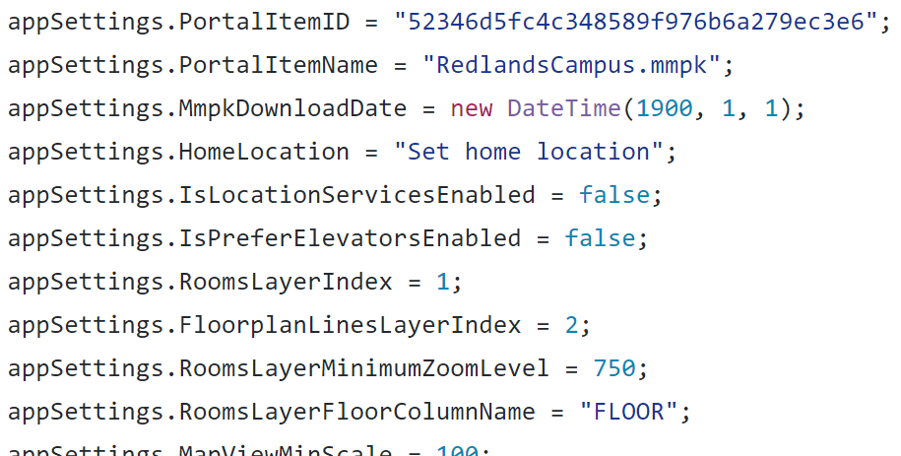
Step 3 – Change App Settings

Slide 14
Step 4 – Run the App
Uninstall the app (on device ) or delete AppSettings.xml file (on simulator)
Run App

Slide 15
Resources

Slide 16
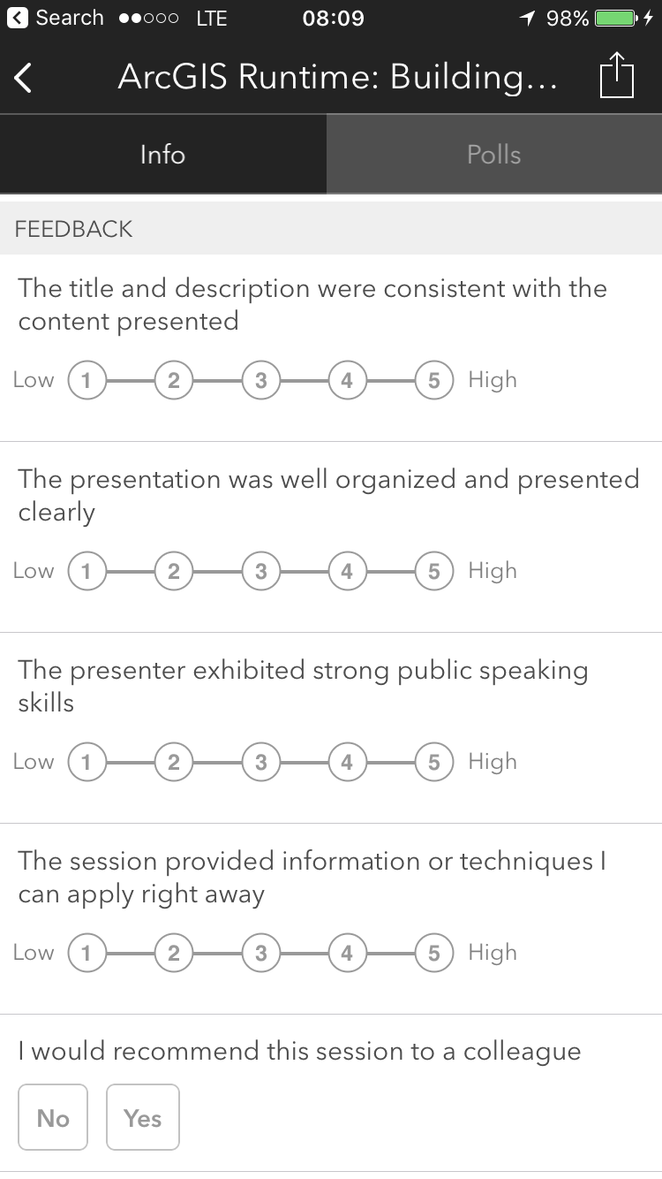
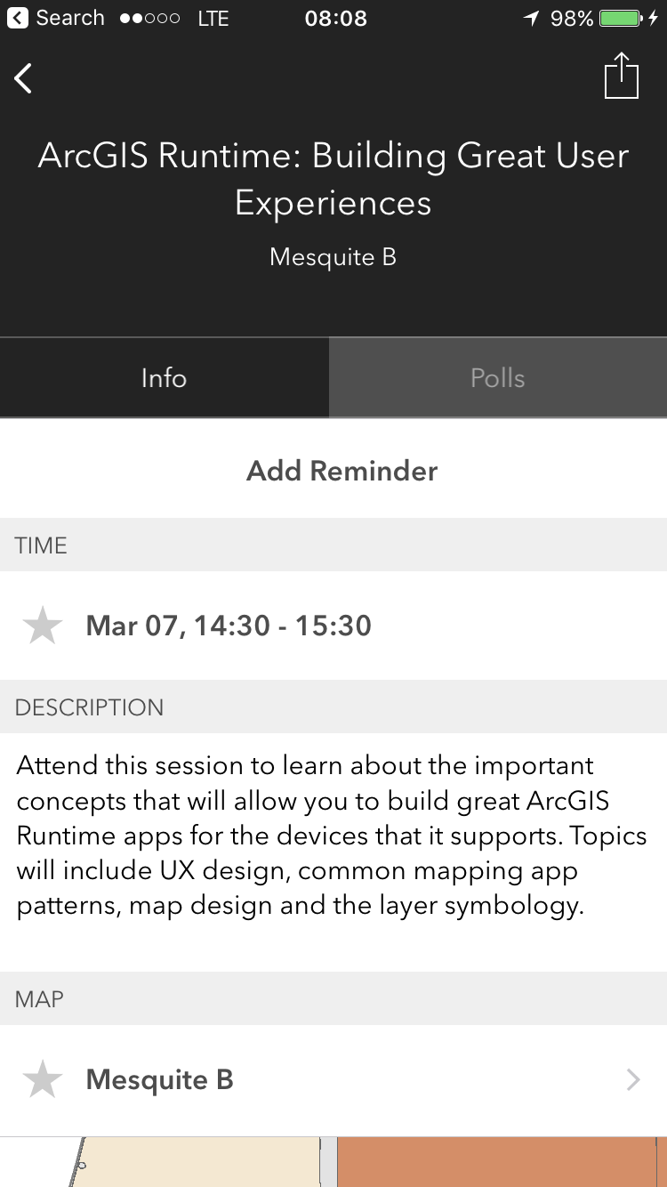


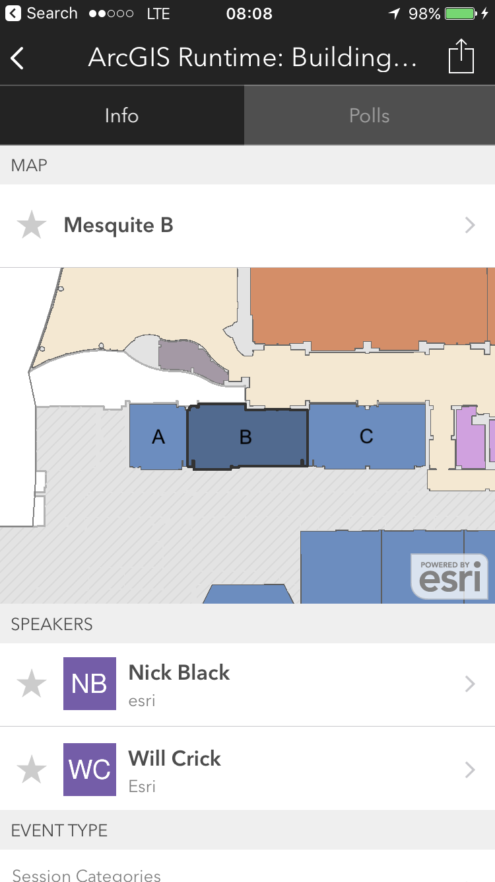
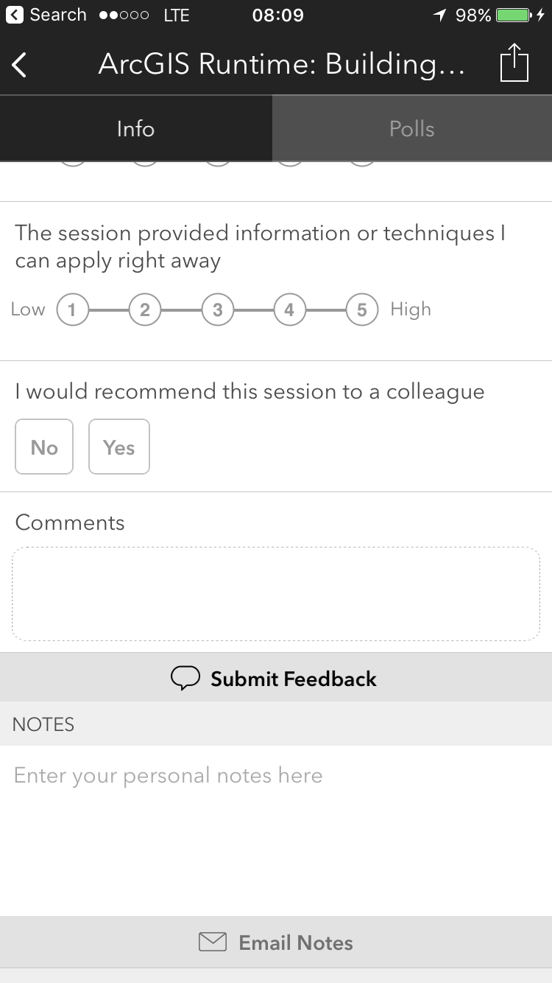
Please Take Our Survey! – No more memorizing Session ID numbers!! ☺
Download the Esri Events app
and find your event
Select the session you
attended
Scroll down to the
“Feedback” section
Complete Answers,
add a Comment,
and Select “Submit”

Slide 17

Resources
Photo Credit: macduff312 Flickr via Compfight cc
Xamarin
Xamarin University
https://developer.xamarin.com/
ArcGIS Runtime for Xamarin
https://developers.arcgis.com/net/
https://geonet.esri.com search for Xamarin
Mara Stoica
Twitter: @codergrl
Email: mstoica@esri.com

